Slide 1
Preprocessing
Dr. Zahid Halim

Slide 2
Introduction
preprocessing
  occurs before a program is compiled.
  inclusion of other files
  definition of symbolic constants and macros,
  conditional compilation of program code
  conditional execution of preprocessor directives
Format of preprocessor directives:
  lines begin with #
  only whitespace characters before directives on a line
  they are not C++ statements - no semicolon (;)

Slide 3
The #include Preprocessor Directive
#include
  copy of a specified file included in place of the directive
  #include <filename> - searches standard library for file (use for standard library files)
  #include "filename" - searches current directory, then standard library (use for user-defined files)
Used for
  loading header files (#include <iostream>)
  programs with multiple source files to be compiled together
  header file - has common declarations and definitions (classes, structures, function prototypes)
    #include statement in each file

Slide 4
The #define Preprocessor Directive: Symbolic Constants
#define
  preprocessor directive used to create symbolic constants and macros.
Symbolic constants
  when program compiled, all occurrences of symbolic constant replaced with replacement text
Format: #define identifier replacement-text
  Example: #define PI 3.14159
  everything to right of identifier replaces text
  #define PI = 3.14159
    replaces "PI" with " = 3.14159", probably results in an error
  cannot redefine symbolic constants with more #define statements

Slide 5
The #define Preprocessor Directive: Macros
Macro - operation defined in #define
  intended for C programs
  macro without arguments: treated like a symbolic constant
  macro with arguments: arguments substituted for replacement text, macro expanded
  performs a text substitution - no data type checking
  Example:
  #define CIRCLE_AREA( x ) ( PI * ( x ) * ( x ) )
  area = CIRCLE_AREA( 4 );
  becomes
  area = ( 3.14159 * ( 4 ) * ( 4 ) );

Slide 6
The #define Preprocessor Directive: Macros (II)
use parenthesis:
  without them,
  #define CIRCLE_AREA( x ) PI * x * x
  area = CIRCLE_AREA( c + 2 );
  becomes
  area = 3.14159 * c + 2 * c + 2;
  which evaluates incorrectly
multiple arguments:
  #define RECTANGLE_AREA( x, y ) ( ( x ) * ( y ) )
  rectArea = RECTANGLE_AREA( a + 4, b + 7 );
  becomes
  rectArea = ( ( a + 4 ) * ( b + 7 ) );
#undef
  undefines a symbolic constant or macro, which can later be redefined
  #define WIDTH 80
  #define ADD( X, Y ) ((X) + (Y)) . . .
  #undef WIDTH
  #undef ADD

Slide 7
Conditional Compilation
conditional compilation
  control preprocessor directives and compilation
  cast expressions, sizeof, enumeration constants cannot be evaluated
structure similar to if
  #if !defined( NULL )
  #define NULL 0
  #endif
  determines if symbolic constant NULL defined
    if NULL is defined, defined(NULL) evaluates to 1
    if NULL not defined, defines NULL as 0
  every #if ends with #endif
  #ifdef short for #if defined(name)
  #ifndef short for #if !defined(name)

Slide 8
Conditional Compilation (II)
Other statements:
  #elif - equivalent of else if in an if structure
  #else - equivalent of else in an if structure
"Comment out" code
  cannot use /* ... */
  use
    #if 0
      code commented out
    #endif
  to enable code, change 0 to 1

Slide 9
The # and ## Operators
# - replacement text token converted to string with quotes
  #define HELLO( x ) cout << "Hello, " #x << endl;
  HELLO(John) becomes
  cout << "Hello, " "John" << endl;
    strings separated by whitespace are concatenated when using cout
## - concatenates two tokens
  #define TOKENCONCAT( x, y ) x ## y
  TOKENCONCAT( O, K ) becomes
  OK
Notice #

Slide 10
Line Numbers
#line
  renumbers subsequent code lines, starting with integer value
  file name can be included
#line 100 "myFile.c"
  lines are numbered from 100 beginning with next source code file
  for purposes of errors, file name is "myFile.c"
  makes errors more meaningful
  line numbers do not appear in source file

Slide 11
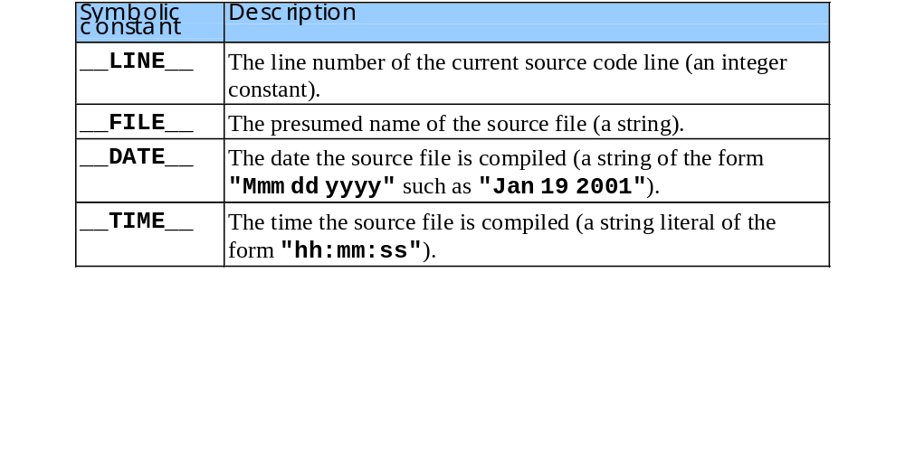
Predefined Symbolic Constants
Five predefined symbolic constants
  cannot be used in #define or #undef

Slide 12
Assertions
assert macro
  header <cassert>
  tests value of an expression
  if 0 (false) prints error message and calls abort
  assert( x <= 10 );
if NDEBUG defined, all subsequent assert statements ignored
  #define NDEBUG

Slide 13
References
Book Code: A

